Slide 1
CTI VACUUM SEMINAR
WELCOME TO
CTI-CRYOGENICS’
VACUUM SEMINAR

Slide 2
CTI-CRYOGENICS
What Is Vaccum ?

Slide 3
CTI-CRYOGENICS
What Is Vaccum ?
Nothing but a misspelled word !

Slide 4
CTI-CRYOGENICS
What Is Vacuum ?
Vacuum is the reduction in density of free gas molecules within a chamber.

Slide 5
CTI-CRYOGENICS
A cubic centimeter of air contains about
30,000,000,000,000,000,000 (3x10¹⁹) molecules.
At the best ultrahigh-vacuum level achieved, 10⁻¹² Torr, there are still 30,000 molecules per cm³.
A molecule of nitrogen (N₂) travels with an average speed of 500 m/s - about that of a rifle bullet.
Even at the highest vacuum levels achieved in a laboratory, a square centimeter of chamber surface experiences 400,000,000 molecular strikes every second.

Slide 6
CTI-CRYOGENICS
Why Vacuum?
Controlled Atmosphere
  Remove reactive gases
Long Mean Free Path
  Reduce molecular density & collisions
  Clear path for source material
Attain Plasma Conditions
  Constant pressure supporting an ionized gas environment

Slide 7
CTI-CRYOGENICS
Seminar Objectives
Terms and Concepts
Vacuum Fundamentals
Cryopumping Basics
Ion Implant Optimization
Notes:
OVERVIEW OF WHAT WE WILL DISCUSS

Slide 8
CTI-CRYOGENICS
Seminar Objectives
Terms and Concepts
Vacuum Fundamentals
Cryopumping Basics
Ion Implant Optimization
Notes:
OVERVIEW OF WHAT WE WILL DISCUSS

Slide 9
TERMS AND CONCEPTS:
Topics:
Molecular Motion
Pressure
Equilibrium
Flow
Air Composition
Surface Characteristics

Slide 10
TERMS AND CONCEPTS:
Topics:
Molecular Motion
Pressure
Equilibrium
Flow
Air Composition
Surface Characteristics

Slide 11
TERMS AND CONCEPTS:
Molecular Motion
Kinetic Theory of Matter
Collisions
Density
Mean-Free Path

Slide 12
TERMS AND CONCEPTS:
Molecular Motion - Kinetic Theory of Matter
Molecules are never at rest.

Slide 13
TERMS AND CONCEPTS:
Molecular Motion - Kinetic Theory of Matter
Molecules are never at rest.
Continual state of rapid, random motion.

Slide 14
TERMS AND CONCEPTS:
Molecular Motion - Kinetic Theory of Matter
Molecules are never at rest.
Continual state of rapid, random motion.
Gas molecules move in straight lines and many directions with various speeds.

Slide 15
TERMS AND CONCEPTS:
Molecular Motion - Kinetic Theory of Matter
Molecules continue to move in a straight line until influenced off of that line by an external force.
External forces are usually supplied by collisions with other objects.

Slide 16
TERMS AND CONCEPTS:
Molecular Motion - Collisions
Contact with chamber surfaces.

Slide 17
TERMS AND CONCEPTS:
Molecular Motion - Collisions
Contact with chamber surfaces.
Colliding with other molecules moving in different directions and with varying speeds.

Slide 18
TERMS AND CONCEPTS:
Molecular Motion - Collisions
Contact with chamber surfaces.
Colliding with other molecules moving in different directions and with varying speeds.
Actual motion is a combination of these factors.

Slide 19
TERMS AND CONCEPTS:
Molecular Motion - Collisions
As a result of these collisions, the actual path of a molecule would appear random.
The number and frequency of collisions a molecule experiences is related to its speed and the density of molecules.

Slide 20
TERMS AND CONCEPTS:
Molecular Motion - Density
Defined as the number of molecules in a volume: d = N/V.
Density is a measure of the number of molecules in a volume and indicates their average separation.
The volume is generally a constant.

Slide 21
TERMS AND CONCEPTS:
Molecular Motion - Mean-Free Path
Mean-Free Path is defined as the average distance a molecule travels between collisions with other molecules.
Determined by:
  Density and size of molecules
  Pressure

Slide 22
TERMS AND CONCEPTS:
Molecular Motion - Mean-Free Path
For a fixed volume, the Mean-Free Path will be greater when molecules are at a lower density . . .

Slide 23
TERMS AND CONCEPTS:
Molecular Motion - Mean-Free Path
For a fixed volume, the Mean-Free Path will be greater when molecules are at a lower density . . .
. . . and shorter when molecules are at a higher density.

Slide 24
TERMS AND CONCEPTS:
Molecular Motion - Mean-Free Path
Vacuum Facts and Analogies
Pressure
(mm Hg)
760
10⁻²
10⁻⁵
10⁻⁹
10⁻¹²
Molecular
Density (cm³)
2.5 x 10¹⁹
3.2 x 10¹⁴
3.2 x 10¹¹
3.2 x 10⁷
32,000
Mean-Free Path
Between Collisions
.67 
.5 cm
5.1 m
51 km
51,000 km
Baseball
Separation
1 yard
¹/₄ mile
50 miles
Baseball Path
Between Collisions
44 feet
690 miles
6.9 x 10⁵
miles
6.9 x 10⁹
miles
6.9 x 10¹²
miles
New York
to
Chicago
3 Trips
to Moon
37 Trips
to Sun
and Back
1.2
Light
Years
Path Examples

Slide 25
TERMS AND CONCEPTS:
Topics:
Molecular Motion
Pressure
Equilibrium
Flow
Air Composition
Surface Characteristics

Slide 26
TERMS AND CONCEPTS:
Pressure
PRESSURE
Force applied over an area.

Slide 27
TERMS AND CONCEPTS:
Pressure
A moving molecule has momentum equal to its mass times velocity.

Slide 28
TERMS AND CONCEPTS:
Pressure
A moving molecule has momentum equal to its mass times velocity.
When this molecule collides with a chamber wall, its momentum is transferred to the wall at that point.

Slide 29
TERMS AND CONCEPTS:
Pressure
Subsequent collisions immediately add more force over the wall area.

Slide 30
TERMS AND CONCEPTS:
Pressure
Subsequent collisions immediately add more force over the wall area.
The total pressure is calculated by adding all of the forces supplied by all of the molecules colliding with all of the chamber walls.

Slide 31
TERMS AND CONCEPTS:
Pressure
UNITS
of
PRESSURE
1 Atmosphere (atm) = 760 Torr
= 1.013 x 10⁵ Pa
= 14.7 lb/in² (psi)
1 Torr = 1000 milliTorr (microns)

Slide 32
TERMS AND CONCEPTS:
Pressure
Torr
Pa
miles (km)
10⁻¹²
10⁻¹⁰
1000 (1609)
Pressure
10⁻¹⁰
10⁻⁸
Altitude
400 (644)
}
10⁻⁸
10⁻⁶
}
Space Shuttle
200 (322)
10⁻⁶
10⁻⁴
100 (161)
Low-Earth Satellites
10⁻²
80 (129)
10⁻⁴
60 (97)
10⁻²
1
40 (64)
Aircraft
1
100
}
}
20 (32)
Science Balloons
100
10⁴
}
Cirrus Clouds
760
10⁵
0 Sea Level

Slide 33
TERMS AND CONCEPTS:
Topics:
Molecular Motion
Pressure
Equilibrium
Flow
Air Composition
Surface Characteristics

Slide 34
TERMS AND CONCEPTS:
Equilibrium
Equilibrium Vapor Pressure
Surface Equilibrium

Slide 35
TERMS AND CONCEPTS:
Equilibrium
EQUILIBRIUM VAPOR PRESSURE
State where as many molecules are condensing as are vaporizing.
A very important concept related to cryopumps.

Slide 36
TERMS AND CONCEPTS:
Equilibrium - Equilibrium Vapor Pressure
In a chamber kept at a uniform temperature over time (isothermal), molecules can exist in several states;
  Gas
  Liquid
  Solid
Gas
Liquid/Solid
Notes:
FURTHER VISUALIZATION OF RANDOM MOL MOTION: IF THE PRESSURE ON ONE SIDE IS AT ATMOSPHERE AND THE OTHER SIDE IS AT 10-4... THE EQUALIZATION OF THE PRESSURE WILL BE IN 3 SECONDS, FOR EXAMPLE...

Slide 37
TERMS AND CONCEPTS:
Equilibrium - Equilibrium Vapor Pressure
Equilibrium occurs when the rate of gas molecules returning to the liquid/solid (condensing) is equal to the rate of energetic molecules becoming gaseous (vaporizing).

Slide 38
TERMS AND CONCEPTS:
Equilibrium - Equilibrium Vapor Pressure
All elements (gases) have a specific Saturation Pressure for a given temperature - called the “Equilibrium Vapor Pressure”.
Saturated Gas at
Equilibrium Vapor
Pressure
EQUILIBRIUM VAPOR PRESSURE
10⁻¹⁰ 10⁻⁷ 10⁻⁴ 10⁻³
Water 130K 153K 185K 198.5K
Argon 23.7K 28.6K 35.9K 39.2K

Slide 39
TERMS AND CONCEPTS:
Equilibrium
SURFACE EQUILIBRIUM
State where as many molecules are arriving on a surface as are leaving.
A very important concept related to cryopumps.

Slide 40
TERMS AND CONCEPTS:
Equilibrium - Surface Equilibrium
At lower density and pressure, molecules no longer condense and vaporize.
  Arrival is adsorption
  Departure is desorption

Slide 41
TERMS AND CONCEPTS:
Equilibrium - Surface Equilibrium
When the number of molecules arriving on the chamber surface (adsorbing) equals the number leaving the surface (desorbing), then the system is in “Surface Equilibrium”.

Slide 42
TERMS AND CONCEPTS:
Topics:
Molecular Motion
Pressure
Equilibrium
Flow
Air Composition
Surface Characteristics

Slide 43
TERMS AND CONCEPTS:
Flow
Pumping Speed
Throughput
Conductance
Types - Regimes
Backstreaming

Slide 44
TERMS AND CONCEPTS:
Flow
PUMPING SPEED
(Volumetric Flow)
Volume of gas that passes a plane in a known time.
The most commonly used measure to evaluate the performance of a high vacuum pump.
UNITS OF SPEED
Liters per Second

Slide 45
TERMS AND CONCEPTS:
Flow - Pumping Speed
Describes the volumetric gas flow in a pipe based on:
  Volume
  Time
Volume (V)
Speed (S) =
Time (t)
V
(t₂ - t₁)
UNITS OF SPEED
Liters per Second
t₁
t₂

Slide 46
TERMS AND CONCEPTS:
Flow
THROUGHPUT
The volume of gas at a known pressure that passes a plane in a known time.
UNITS OF THROUGHPUT
Torr-Liters per Second

Slide 47
TERMS AND CONCEPTS:
Flow - Throughput
Describes the volumetric gas flow in a pipe at a specific pressure:
  Pressure
  Volume
  Time
Throughput (Q)
=
Speed (S) X Pressure (P)
=
Volume (V)
X Pressure (P)
Time (t)
V
=
X P
(t₂ - t₁)
UNITS OF THROUGHPUT
Torr-Liters per Second
t₁
t₂

Slide 48
TERMS AND CONCEPTS:
Flow
Flow - Throughput
THROUGHPUT
Can also be defined as:
The quantity of gas molecules entering the pump in a given unit of time.
Throughput equals Pressure times Speed
(Q = P ^{x} S)

Slide 49
TERMS AND CONCEPTS:
Flow - Throughput
THROUGHPUT
As the cryo’s throughput goes up, the time to capacity goes down. Working at higher pressures means more frequent regens.
UNITS OF THROUGHPUT
Torr-Liters per Second

Slide 50
TERMS AND CONCEPTS:
Flow - Throughput
THROUGHPUT
A cryopump’s throughput is limited by its refrigeration
capacity.
There is a maximum throughput specified as the constant flow of gas that can be supplied to a pump without raising the temperature of the second stage over 20 K - it is a measure of the cryopump’s refrigeration capabilities.

Slide 51
TERMS AND CONCEPTS:
Flow
CONDUCTANCE
A term used to describe the ability of gas to flow through a vacuum system.
Generally, high conductance is better than low. Vacuum system designers attempt to minimize conductance losses by using large diameter tubes and no elbows.
UNITS OF CONDUCTANCE: Liters per Second

Slide 52
TERMS AND CONCEPTS:
Flow - Conductance (in molecular flow)
For a round pipe, conductance depends on the:
  Type of gas (M)
  Temperature of pipe (T)
  Diameter of pipe (D)
  Length of pipe (L)
T
D³
C_{pipe}
=
k
M
L
where,
M is molecular weight
T is in kelvin
D is in centimeters
L is in centimeters
Recommendation:
Use big, short pipes.

Slide 53
TERMS AND CONCEPTS:
Flow - Conductance
For a cylindrical pipe elbow the conductance is determined by:
  Diameter of pipe
  Effective Length of elbow
  Angle of elbow
Conductance (C)
=
Length₁ (L₁) + Length₂ (L₂)
Θ
1.33 ( ) X Diam. (D)
+
180
Θ
L₁ + L₂ + 1.33 ( ) X D
=
180
Θ
L₂
UNITS OF CONDUCTANCE
Liters per Second
L₁

Slide 54
TERMS AND CONCEPTS:
Flow - Conductance
Combined conductance of both straight pipes and elbows is calculated by summing all individual segments.
Combined Conductance
1
1
1
1
=
+
+
C_{total}
C₁
C₂
C₃
C₁
C₂
C₃
UNITS OF CONDUCTANCE
Liters per Second

Slide 55
TERMS AND CONCEPTS:
Flow
GAS FLOW REGIMES
Flow regimes are characterized by the mean-free path of the gas and dimensions of the system.
Notes:
DISCUSS

Slide 56
TERMS AND CONCEPTS:
Flow - Regimes
Gas Flow Regimes:
Turbulent
  Irregular Flow, Many Eddies
Viscous
  Regular Flow, No Eddies
Transitional
  Mean-Free Path is Smaller
  than Pipe Diameter
Molecular
  Molecules Independent of Others
Notes:
DISCUSS

Slide 57
TERMS AND CONCEPTS:
Flow - Regimes
Typical Flow Ranges In Roughing Lines:
Turbulent
  760 Torr to 50 Torr
Viscous
  50 Torr to 200 milliTorr
Transitional
  200 milliTorr to 3 milliTorr
Molecular
  3 milliTorr or Below

Slide 58
TERMS AND CONCEPTS:
Flow - Regimes
Gas Flow Regimes
(mm)
(inches)
10³
10²
10
1
10⁻¹
10⁻²
10⁴
10³
10²
10
1
Viscous Flow
Transitional Flow
Diameter
Data based on Nitrogen
at a Temperature of 20º C
Molecular Flow
10⁻⁶ 10⁻⁵ 10⁻⁴ 10⁻³ 10⁻² 10⁻¹ 1 10 10² (Torr)
10⁻⁴ 10⁻³ 10⁻² 10⁻¹ 1 10 10² 10³ 10⁴ (Pa)
Pressure
Notes:
DISCUSS

Slide 59
TERMS AND CONCEPTS:
Flow
BACKSTREAMING
Migration of pump fluid molecules from the rough vacuum pump toward the vacuum chamber.

Slide 60
TERMS AND CONCEPTS:
Flow - Backstreaming
Kinetic Theory
  Molecules are never at rest.
  Continual state of rapid, random motion.
  Gas molecules move in straight lines and many directions with various speeds.

Slide 61
TERMS AND CONCEPTS:
Flow - Backstreaming
Viscous Flow (50 Torr - 200 milliTorr)
  Molecules are directed in uniform motion toward lower pressure
  Random motion of a molecule is influenced in the direction of the mass flow
  Molecular motion “against” mass flow unlikely
Process Chamber
Rough
Valve
High P
Rough
Line
Rough
Pump
Low P

Slide 62
TERMS AND CONCEPTS:
Flow - Backstreaming
Transitional Flow (200 milliTorr - 3 milliTorr)
  The Mean-Free-Path is less than the diameter of the rough line
  Molecules collide with other molecules and rough line walls
Process Chamber
Collisions
With Walls
And
Molecules

Slide 63
TERMS AND CONCEPTS:
Flow - Backstreaming
Transitional Flow (200 milliTorr - 3 milliTorr)
  Molecular density is such that there is still an overall flow in the direction of the pump
  Enough separation between molecules for some to migrate in other direction - backstreaming
Process Chamber
Chamber
Oil
Pump

Slide 64
TERMS AND CONCEPTS:
Flow - Backstreaming
Molecular Flow (3 milliTorr and less)
  The Mean-Free-Path is greater than the diameter of the rough line
  Molecules do not interact with other molecules
  Progression down rough line toward rough pump is with random motion
Process Chamber
Collisions
With Walls
Only
At the molecular level,
the physical world changes.

Slide 65
TERMS AND CONCEPTS:
Flow - Backstreaming
Molecular Flow (3 milliTorr and less)
  Molecules randomly move in either direction - to or away from rough pump and vacuum pump
  Backstreaming probable in this flow regime
Process Chamber
Chamber
Oil
Pump

Slide 66
TERMS AND CONCEPTS:
Topics:
Molecular Motion
Pressure
Equilibrium
Flow
Air Composition
Surface Characteristics

Slide 67
TERMS AND CONCEPTS:
Air Composition
Air Constituents
Atmospheric Pressures
Vacuum Pressures

Slide 68
TERMS AND CONCEPTS:
Air Composition - Air Constituents
COMPOSITION OF ATMOSPHERIC AIR
(50% Humidity at 20º C)
    Percent by Volume
    Nitrogen (N₂) 78%
    Oxygen (O₂) 21%
    Argon (Ar) .95%
    Water (H₂O) .75%
    Carbon Dioxide (CO₂) .03%
    Neon (Ne) .0018%
    Helium (He) .000524%
Notes:
DISCUSS...THE PROBLEM IS THAT HERE ON THE ‘WATER PLANET’ WE HAVE A LOT OF WATER.... THE LONG TERM MESSAGE IS THAT WATER IS THE MAIN GAS LOAD...

Slide 69
TERMS AND CONCEPTS:
Air Composition - Atmospheric Pressures
Nitrogen: 78%
Pressures Above 10⁻³ Torr

Slide 70
TERMS AND CONCEPTS:
Air Composition - Atmospheric Pressures
Nitrogen: 78%
Oxygen: 21%
Pressures Above 10⁻³ Torr

Slide 71
TERMS AND CONCEPTS:
Air Composition - Atmospheric Pressures
Nitrogen: 78%
Oxygen: 21%
Water: 1%
Pressures Above 10⁻³ Torr

Slide 72
TERMS AND CONCEPTS:
Air Composition - Vacuum Pressures
Nitrogen: <1%
Oxygen: <1%
Pressures Below 10⁻³ Torr

Slide 73
TERMS AND CONCEPTS:
Air Composition - Vacuum Pressures
Water: 98%
Nitrogen: <1%
Oxygen: <1%
Pressures Below 10⁻³ Torr

Slide 74
TERMS AND CONCEPTS:
Topics:
Molecular Motion
Pressure
Equilibrium
Flow
Air Composition
Surface Characteristics

Slide 75
TERMS AND CONCEPTS:
Surface Characteristics
Polar Molecules
Surface Layering
Outgassing

Slide 76
TERMS AND CONCEPTS:
Surface Characteristics
POLAR MOLECULES
Asymmetric gas molecules with one end charged positive and the other end charged negative.

Slide 77
TERMS AND CONCEPTS:
Surface Characteristics - Polar Molecules
A water molecule is made-up of two hydrogen atoms with positive charges and one oxygen atom with a negative charge.
The 105º molecular bond orientation results in opposite sides having different polarities.
H
+
-
O
105º
+
H

Slide 78
TERMS AND CONCEPTS:
Chamber Characteristics - Polar Molecules
Asymmetric molecules like water are called “polar” .
Polar molecules are attracted to other molecules and surfaces with an opposite charge.
H
+
--
O
+
H
This ability to attach to other objects is why water is so useful in chemistry and other sciences, and such a problem in vacuum technology.

Slide 79
TERMS AND CONCEPTS:
Chamber Characteristics - Polar Molecules
Water is the primary gas at vacuum pressures because it is a polar molecule.
The polarity of water and other molecules results in surface layering on vacuum chamber walls.
Water: 98%
Nitrogen: <1%
Oxygen: <1%
Pressures Below 10⁻³ Torr

Slide 80
TERMS AND CONCEPTS:
Chamber Characteristics
SURFACE LAYERING
Vacuum chamber walls exposed to atmospheric air and process gases will have a significant amount of water and other molecules temporarily attached as layers.

Slide 81
TERMS AND CONCEPTS:
Chamber Characteristics - Surface Layering
1-2 Layers of H₂, CO, Residual Gases
5-100 Layers of Physisorbed Water
1-2 Layers Chemisorbed Water, H₂, O₂, N₂
Single Layer of Stable Oxides
Vacuum Chamber Wall
Notes:
IF YOU COULD TAKE A SLICE OUT OF THE CHAMBER WALL.... HERE IS WHAT THE LAYERS WOULD LOOK LIKE...

Slide 82
TERMS AND CONCEPTS:
Chamber Characteristics
OUTGASSING
Outgassing is the process by which atmospheric and other gases evolve from chamber surfaces when exposed to high vacuum.
The outgassing rate is measured in
torr-liters per second per cm².

Slide 83
TERMS AND CONCEPTS:
Chamber Characteristics - Outgassing
Outgassing depends on several factors:
  Gas Characteristics

Slide 84
TERMS AND CONCEPTS:
Chamber Characteristics - Outgassing
Outgassing depends on several factors:
  Gas Characteristics
  Surface Temperature

Slide 85
TERMS AND CONCEPTS:
Chamber Characteristics - Outgassing
Outgassing depends on several factors:
  Gas Characteristics
  Surface Temperature
  Exposure Time to Vacuum
These factors, combined with polar properties, contribute to water being such a problem at high vacuum.

Slide 86
TERMS AND CONCEPTS:
Chamber Characteristics - Outgassing
The quantity of evolved gas is the chamber volume times the pressure change (Torr-liters).
The outgassing rate, or quantity of gas evolved over time, is measured in Torr-liters per second per cm².

Slide 87
CTI-CRYOGENICS
Seminar Objectives
Terms and Concepts
Vacuum Fundamentals
Cryopumping Basics
Ion Implant Optimization
Notes:
OVERVIEW OF WHAT WE WILL DISCUSS

Slide 88
VACUUM FUNDAMENTALS:
What Is Vacuum ?
Vacuum is the reduction in density of free
gas molecules within a chamber.

Slide 89
VACUUM FUNDAMENTALS:
Topics:
Vacuum Levels
Molecular Motion Revisited
Chamber Evacuation
Vacuum Pumps

Slide 90
VACUUM FUNDAMENTALS:
Topics:
Vacuum Levels
Molecular Motion Revisited
Chamber Evacuation
Vacuum Pumps

Slide 91
VACUUM FUNDAMENTALS:
Vacuum Levels
Torr
Pa
miles (km)
Pressure
10⁻¹²
10⁻¹⁰
Altitude
Ultra-High
Vacuum
1000 (1609)
10⁻¹⁰
10⁻⁸
{
400 (644)
10⁻⁸
10⁻⁶
Typical Semiconductor Base Pressures
{
200 (322)
High
Vacuum
10⁻⁶
10⁻⁴
100 (161)
10⁻⁴
10⁻²
80 (129)
60 (97)
Semiconductor Process Pressures
10⁻²
1
Rough
Vacuum
40 (64)
1
100
20 (32)
100
10⁴
760
10⁵
0 Sea Level

Slide 92
VACUUM FUNDAMENTALS:
Topics:
Vacuum Levels
Molecular Motion Revisited
Chamber Evacuation
Vacuum Pumps

Slide 93
VACUUM FUNDAMENTALS:
Molecular Motion Revisited - Kinetic Theory
Molecules are never at rest.
Continual state of rapid, random motion.
Gas molecules move in straight lines and many directions with various speeds.

Slide 94
VACUUM FUNDAMENTALS:
Molecular Motion Revisited - Kinetic Theory
Molecules continue to move in a straight line until influenced off of that line by an external force.
External forces are usually supplied by collisions with other objects.

Slide 95
VACUUM FUNDAMENTALS:
Molecular Motion Revisited - Collisions
Contact with chamber surfaces.
Colliding with other molecules moving in different directions and with varying speeds.
Actual motion is a combination of these factors.

Slide 96
VACUUM FUNDAMENTALS:
Molecular Motion Revisited - Collisions
As a result of the molecule’s speed and these collisions, its motion appears as a random path about the enclosure.
Over time, a molecule will contact many other molecules and chamber surfaces.

Slide 97
VACUUM FUNDAMENTALS:
Topics:
Vacuum Levels
Molecular Motion Revisited
Chamber Evacuation
Vacuum Pumps

Slide 98
VACUUM FUNDAMENTALS:
Chamber Evacuation
If an opening were placed in the chamber wall, then eventually a molecule’s path would be directed through that opening.

Slide 99
VACUUM FUNDAMENTALS:
Chamber Evacuation
If an opening were placed in the chamber wall, then eventually a molecule’s path would be directed through that opening.
Then, capturing the molecule would prevent its return to the chamber.

Slide 100
VACUUM FUNDAMENTALS:
Chamber Evacuation
Over time, more molecules will pass through the opening and be captured.

Slide 101
VACUUM FUNDAMENTALS:
Chamber Evacuation
Over time, more molecules will pass through the opening and be captured.
As this occurs, fewer and fewer molecules remain in the chamber.

Slide 102
VACUUM FUNDAMENTALS:
Chamber Evacuation
Over time, more molecules will pass through the opening and be captured.
As this occurs, fewer and fewer molecules remain in the chamber.
Finally, only a fraction of the original number of molecules are left.

Slide 103
VACUUM FUNDAMENTALS:
Chamber Evacuation
In an actual process chamber the “air gases” (N₂, O₂, etc.) are evacuated from atmosphere by vacuum pumps very quickly.
But, because water vapor remains on chamber walls and the gas is now in molecular flow, pumpdown slows considerably.
Water: 98%
Nitrogen: <1%
Oxygen: <1%
Pressures Below 10⁻³ Torr

Slide 104
VACUUM FUNDAMENTALS:
Topics:
Vacuum Levels
Molecular Motion Revisited
Chamber Evacuation
Vacuum Pumps

Slide 105
VACUUM FUNDAMENTALS: Vacuum Pumps
Types:
Diffusion Pump
Turbopump
Cryopump
Waterpump
Pumping System Ranges
Crossover

Slide 106
VACUUM FUNDAMENTALS: Vacuum Pumps - Types
THROUGHPUT
Diffusion Pump
Turbopump
CAPTURE
Cryopump
Ion Pump
SPECIALIZED CAPTURE
Waterpump

Slide 107
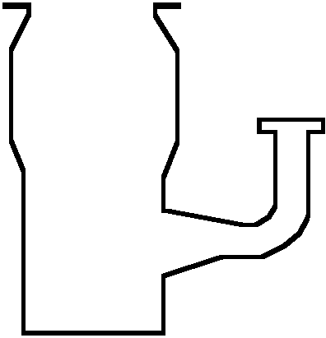
VACUUM FUNDAMENTALS: Vacuum Pumps - Diffusion Pump
Characteristics:
  Relatively good vacuum
  Long operational lifetime
  No moving parts
  Minimal maintenance
  Oil backstreaming
  Heat input effects
  Require water cooling
  Mechanical pump required for discharge
  Limited orientations
Flange
Jets
Cooling
Coils
Pump
Body
Oil Boiler
Heater
Throughput Type Pump

Slide 108
VACUUM FUNDAMENTALS: Vacuum Pumps - Turbopump
Characteristics:
  Relatively clean and simple operation
  Fast start-up
  Pumping speed about equal for all gases
  Low water speed
  Low compression ratio for light gases
  Multiple orientations
Inlet
Flange
Rotor
Blades
Stator
Blades
Pump
Body
Outlet
Motor Assembly
Throughput Type Pump

Slide 109
VACUUM FUNDAMENTALS: Vacuum Pumps - Turbopump
Characteristics:
  Bearing maintenance
  Susceptible to contamination
  High cost for liters/sec
Inlet
Flange
Rotor
Blades
Stator
Blades
Pump
Body
PUMPING SPEEDS
(liters/second)
4” 6” 8” 10” 16”
Water 200 400 900 1,300 4,000
Air (N₂) 68 280 550 1,000 3,400
Hydrogen 45 210 510 1,150 3,200
Argon 57 235 462 840 2,856
Outlet
Motor Assembly
Throughput Type Pump

Slide 110
VACUUM FUNDAMENTALS: Vacuum Pumps - Cryopump
Characteristics:
  Cleanest high vacuum pump
  No fluids, lubricants, or moving parts
  High crossover capability minimizes backstreaming
  Highest pumping speeds
  Tailorable pumping speeds
  Fast system pumpdown
Flange
1st Stage
Array
2nd Stage
Array
Radiation
Shield
Vacuum
Vessel
Central
Processor
Capture Type Pump

Slide 111
VACUUM FUNDAMENTALS: Vacuum Pumps - Cryopump
Characteristics:
  Operates in all orientations
  Limited He capacity
  Regeneration
  Thermal shielding for high temperature sources
Flange
1st Stage
Array
2nd Stage
Array
Radiation
Shield
PUMPING SPEEDS
(liters/second)
Vacuum
Vessel
4” 8” 8”(F) 10” 16”
Water 1,100 4,000 4,000 9,000 16,000
Air 370 1,500 1,500 3,000 6,000
Hydrogen 370 2,500 2,200 5,000 12,000
Argon 310 1,200 1,200 2,500 5,000
Central
Processor
Capture Type Pump

Slide 112
VACUUM FUNDAMENTALS: Vacuum Pumps - Waterpump
Features:
  “Booster” pump
  High water vapor pumping
  Does not condense process gases
  Can be located inside chamber - speed not limited by port size
Process Chamber
Cryopanel
Array
Process
Chamber
Wall
PUMPING SPEEDS
(liters/second)
Control
Module
4” 6” 8” 10” 16”
Water 1,100 2,500 4,000 7,000 16,000
Specialized Capture Type Pump

Slide 113
VACUUM FUNDAMENTALS: Vacuum Pumps
Pumping System Ranges
Ultra-High Vacuum
High Vacuum
Rough Vacuum
Mechanical
Turbomolecular backed with 2 Stage Mechanical Pump
Oil Diffusion Pump with Cold Trap
Cryopump
Waterpump
10⁻¹⁰ 10⁻⁹ 10⁻⁸ 10⁻⁷ 10⁻⁶ 10⁻⁵ 10⁻⁴ 10⁻³ 10⁻² 760
Pressure (Torr)

Slide 114
VACUUM FUNDAMENTALS: Vacuum Pumps - Crossover
Crossover
During chamber evacuation,
when should the high-vacuum valve be opened?

Slide 115
VACUUM FUNDAMENTALS: Vacuum Pumps - Crossover
Crossover
During chamber evacuation,
when should the high-vacuum valve be opened?
This is specified by the manufacturer and depends on the individual pump and chamber size.
For cryopumps, the maximum crossover capability is specified as the impulsive mass input that causes the second stage to rise no higher than 20 K.

Slide 116
CRYOPUMP OPERATIONS: Vacuum Pumps - Crossover
Crossover Pressure Calculation
Crossover value for On-Board 8 = 150 Torr-liters
Crossover formula: ^{Crossover value} = P in Torr
Chamber volume
^{150 Torr-liters} = .5 Torr or 500 milliTorr
300 liters
Benefit:
Taking advantage of this cryopump feature gives you faster pumpdown and cleaner vacuum too.

Slide 117
CTI-CRYOGENICS
Seminar Objectives
Terms and Concepts
Vacuum Fundamentals
Cryopumping Basics
Ion Implant Optimization
Notes:
OVERVIEW OF WHAT WE WILL DISCUSS

Slide 118
CRYOPUMPING BASICS:
Topics:
Molecules and Temperature
Capture Theory
Cryopump Concept
System Design
Operation

Slide 119
CRYOPUMPING BASICS:
Topics:
Molecules and Temperature
Capture Theory
Cryopump Concept
System Design
Operation

Slide 120
CRYOPUMPING BASICS:
Molecules and Temperature
Molecules and Temperature
Molecules in constant motion have kinetic energy.
The temperature determines
their average kinetic energy.
The higher the temperature,
the faster the molecules move.

Slide 121
CRYOPUMPING BASICS:
Molecules and Temperature
Molecules and Temperature
Molecules of gas move fastest.
Molecules of liquids move slower.
Molecules of solids move the least.

Slide 122
CRYOPUMPING BASICS:
Molecules and Temperature
Temperature Scales
Three scales are used to measure temperature;
Kelvin (K)
Celsius or Centigrade (ºC)
Fahrenheit (ºF)
The Kelvin (K) temperature scale is used in the
science of cryogenics and vacuum technology.

Slide 123
CRYOPUMPING BASICS:
Molecules and Temperature
Water Boils 373 K 100º C 212º F
Room Temperature 293 K 20º C 68º F
Water Freezes 273 K 0º C 32º F
Nitrogen Boils 77 K -196º C -320º F
Hydrogen Boils 20 K -253º C -423º F
Helium Boils 4.2 K -269º C -452º F
Absolute Zero 0.0 K -273º C -459º F
Notes:
DISCUSS TEMPERATURE, LORD KELVIN... K IS THE TEMPERATURE WE USE IN THE SCIENCE OF CRYOGENICS.... ETC.

Slide 124
CRYOPUMPING BASICS:
Molecules and Temperature
Water Boils 373 K 100º C 212º F
Room Temperature 293 K 20º C 68º F
Water Freezes 273 K 0º C 32º F
Nitrogen Boils 77 K -196º C -320º F
Hydrogen Boils 20 K -253º C -423º F
Helium Boils 4.2 K -269º C -452º F
Absolute Zero 0.0 K -273º C -459º F

Slide 125
CRYOPUMPING BASICS:
Molecules and Temperature
Water Boils 373 K 100º C 212º F
Room Temperature 293 K 20º C 68º F
Water Freezes 273 K 0º C 32º F
Nitrogen Boils 77 K -196º C -320º F
Hydrogen Boils 20 K -253º C -423º F
Helium Boils 4.2 K -269º C -452º F
Absolute Zero 0.0 K -273º C -459º F

Slide 126
CRYOPUMPING BASICS:
Molecules and Temperature
Water Boils 373 K 100º C 212º F
Room Temperature 293 K 20º C 68º F
Water Freezes 273 K 0º C 32º F
Nitrogen Boils 77 K -196º C -320º F
Hydrogen Boils 20 K -253º C -423º F
Helium Boils 4.2 K -269º C -452º F
Absolute Zero 0.0 K -273º C -459º F
No Molecular Activity
Notes:
YES, THAT’S AN ICICLE ON THE THERMOMETER,,,!! (SORRY)

Slide 127
CRYOPUMPING BASICS:
Topics:
Molecules and Temperature
Capture Theory
Cryopump Concept
System Design
Operation

Slide 128
CRYOPUMPING BASICS:
Capture Theory
A chamber could be evacuated if an opening and capture mechanism were provided.
Creating sufficiently cold surfaces, most gases could be captured.

Slide 129
CRYOPUMPING BASICS:
Capture Theory
Cryocondensation
Pumping gases to the extent that gas molecules, upon contacting a cooled surface, lose sufficient energy to form condensation layers.

Slide 130
CRYOPUMPING BASICS:
Capture Theory - Cryocondensation
Hypothetical surfaces of varying temperatures.
4.2 K
20 K
80 K

Slide 131
CRYOPUMPING BASICS:
Capture Theory - Cryocondensation
Most air gases and water vapor are condensed.
4.2 K
20 K
80 K
H₂O
N₂
Ar
H₂
Ne

Slide 132
CRYOPUMPING BASICS:
Capture Theory - Cryocondensation
4.2 K is impractical and Helium still boils.
4.2 K
20 K
80 K
H₂O
N₂
Ar
H₂
Ne
He
Notes:
THE PROBLEM: WE DO NOT HAVE A REFRIGERATOR THAT OPERATES AT 4K... SO WE MOVED THE ‘THIRD STAGE’ TO THE BACK OF THE SECOND STAGE AND BONDED CHARCOAL (1000 SQ METERS / GRAM)... WHEN IT IS COOLED TO BELOW 20k IT BECOMES ‘CRYOADSORBTIVE’...

Slide 133
CRYOPUMPING BASICS:
Capture Theory
Cryoadsorption
Pumping gases to the extent that gas molecules, upon contacting a sufficiently cooled surface, lose enough energy to accumulate on the surface.

Slide 134
CRYOPUMPING BASICS:
Capture Theory - Cryoadsorption
A flat cryoadsorbing plate retains some molecules.
Flat surface allows molecules to continue moving.
Cryoadsorbing Plate
Free
Molecules
Ejected
Molecules
Adsorbed Molecules
Surface Collisions
Cryopumping Surface

Slide 135

CRYOPUMPING BASICS:
Capture Theory - Cryoadsorption
Sieve material, such as charcoal, provides greater surface area and limited apertures.
Large surface area capacity;
  1150-1250 m²/gm
Activated Charcoal
Sieve Material
Limited
Apertures
Internal Cavities

Slide 136
CRYOPUMPING BASICS:
Capture Theory - Cryoadsorption
Increased surface area provides greater capacity.
Released molecules remain confined.
Irregular surface constricts motion.
Cryoadsorption of hydrogen, neon, and helium accomplished.
Activated Charcoal
Free
Molecules
Adsorbed Molecules

Slide 137
CRYOPUMPING BASICS:
Capture Theory - Cryoadsorption
Replace 4.2 K surface with cryoadsorbing sieve material attached to <20 K surface.
<20 K
80 K
2nd Stage
1st Stage

Slide 138
CRYOPUMPING BASICS:
Capture Theory - Cryoadsorption
Air gases and water vapor still condensed - noncondensible gases captured.
<20 K
80 K
H₂O
N₂
Ar
H₂
Ne
He
2nd Stage
1st Stage

Slide 139
CRYOPUMPING BASICS:
Topics:
Molecules and Temperature
Capture Theory
Cryopump Concept
System Design
Operation

Slide 140

CRYOPUMPING BASICS:
Cryopump Concept
Cryopumps are designed to create these condensing and adsorbing surfaces.

Slide 141

CRYOPUMPING BASICS:
Cryopump Concept
Cryopumps pump different gases at different places at different temperatures.
Array spacing provides molecular “Optical Path”
Necessary temperatures are maintained with an integrated control module.
O₂, N₂, Ar
H₂O
H₂, He, Ne
Control
Module

Slide 142
CRYOPUMPING BASICS:
Topics:
Molecules and Temperature
Capture Theory
Cryopump Concept
System Design
Operation

Slide 143
CRYOPUMPING BASICS:
System Design
Topics:
Cryopump Components
Refrigerator
Helium Circuit
System Overview

Slide 144
CRYOPUMPING BASICS:
System Design
Topics:
Cryopump Components
Refrigerator
Helium Circuit
System Overview

Slide 145
CRYOPUMPING BASICS:
System Design - Cryopump Components
A cryopump is built around the cold-head.
  Creates temperatures needed to condense and adsorb gases
  Two stages for different temperatures
Achieves these temperatures by the expansion of helium.
2nd Stage:
12 K
1st Stage:
65 K

Slide 146
CRYOPUMPING BASICS:
System Design - Cryopump Components
A radiation shield is attached to the 1st stage of the cold-head.
  Copper for conductivity
  Nickel plating for protection
The vacuum vessel isolates the cryopump.
The inlet flange attaches to the chamber.
Flange
Radiation
Shield
Vacuum
Vessel

Slide 147
CRYOPUMPING BASICS:
System Design - Cryopump Components
The 1st stage (65 K) array is attached to the radiation shield.
  Condenses water vapor
A series of arrays with charcoal are attached to the 2nd stage (12 K) of the cold-head.
  Condenses O₂, N₂, Ar
  Adsorbs H₂, He, Ne
65 K Array
12 K Arrays
w/ Charcoal

Slide 148
CRYOPUMPING BASICS:
System Design - Cryopump Components
Both the 1st and 2nd stages have an attached heater and temperature sensor to maintain optimum control and operation of the pumping process.
Temperature
Sensors
Heaters

Slide 149
CRYOPUMPING BASICS:
System Design - Cryopump Components
Cryopump functions are monitored and controlled by the control module interfaced to the sensors and heaters.
Control
Module

Slide 150
CRYOPUMPING BASICS:
System Design - Cryopump Components
Cryopump functions are monitored and controlled by the control module interfaced to the sensors and heaters.
  Enhanced performance
  Communications
  Diagnostics

Slide 151
CRYOPUMPING
How is it Done?

Slide 152
CRYOPUMPING BASICS:
System Design
Topics:
Cryopump Components
Refrigerator
Helium Circuit
System Overview

Slide 153
CRYOPUMPING BASICS:
System Design - Refrigerator
Primary Displacer
Stainless housing
Brass screen for thermal mass
Phenolic casing
Helium inlet and exhaust
Displacer
Housing
Brass
Screen
Seal
Exhaust Valve
Inlet Valve

Slide 154
CRYOPUMPING BASICS:
System Design - Refrigerator
Cycle begins with displacer at TDC.
Top-Dead Center (TDC)

Slide 155
CRYOPUMPING BASICS:
System Design - Refrigerator
Cycle Begins with displacer at TDC.
Inlet valve opens.
Displacer moves downward.

Slide 156
CRYOPUMPING BASICS:
System Design - Refrigerator
Cycle begins with displacer at TDC.
Inlet valve opens.
Displacer moves downward.
Helium fills void.

Slide 157
CRYOPUMPING BASICS:
System Design - Refrigerator
At BDC, inlet valve closes.
Exhaust valve opens.
Displacer moves upward.
Gas expands and cools.
Bottom
-Dead
Center
(BDC)

Slide 158
CRYOPUMPING BASICS:
System Design - Refrigerator
Gas flows down through displacer matrix removing heat.
Gas exits through exhaust valve.

Slide 159
CRYOPUMPING BASICS:
System Design - Refrigerator
Displacer again at TDC.

Slide 160
CRYOPUMPING BASICS:
System Design - Refrigerator
Displacer again at TDC.
Remaining gas exits.
Exhaust valve closes.
Cycle repeats at 72 rpm.

Slide 161
CRYOPUMPING BASICS:
System Design - Refrigerator
After each cycle the displacer matrix (thermal mass) is colder ...
... pre-cooling the incoming helium BEFORE expansion.

Slide 162
CRYOPUMPING BASICS:
System Design - Refrigerator
Lead
Shot
Secondary Displacer
Second stage attached to top of primary displacer allows even lower temperatures.
Lead shot for thermal mass.
Phenolic casing.
Displacer
Housing
Seal
Brass
Screen
Seal
Exhaust Valve
Inlet Valve

Slide 163
CRYOPUMPING BASICS:
System Design - Refrigerator
Cycle begins with both displacers at TDC.
Top
-Dead
Center
(TDC)

Slide 164
CRYOPUMPING BASICS:
System Design - Refrigerator
Cycle begins with both displacers at TDC.
Inlet valve opens.
Displacers move downward.

Slide 165
CRYOPUMPING BASICS:
System Design - Refrigerator
Cycle begins with both displacers at TDC.
Inlet valve opens.
Displacers move downward.
Helium fills void above primary displacer and passes through secondary displacer to fill second void.

Slide 166
CRYOPUMPING BASICS:
System Design - Refrigerator
At BDC, inlet valve closes.
Gas has expanded in both voids and cools.
Exhaust valve opens.
Displacers move upward.
Bottom
-Dead
Center
(BDC)

Slide 167
CRYOPUMPING BASICS:
System Design - Refrigerator
Cooled gas flows down through both displacer matrices removing heat from thermal masses.
Gas exits through exhaust valve.

Slide 168
CRYOPUMPING BASICS:
System Design - Refrigerator
Displacers again at TDC.

Slide 169

CRYOPUMPING BASICS:
System Design - Refrigerator
Displacers again at TDC.
Remaining gas exits.
Exhaust valve closes.
Cycle repeats at 72 rpm.

Slide 170
CRYOPUMPING BASICS:
System Design - Refrigerator
After each cycle both displacer matrices (thermal masses) are colder, with the secondary mass colder than the primary ...
... incoming helium is pre-cooled accordingly BEFORE expansion.

Slide 171
CRYOPUMPING BASICS:
System Design
Topics:
Cryopump Components
Refrigerator
Helium Circuit
System Overview

Slide 172
CRYOPUMP OPERATIONS
System Design - Helium Curcuit:
Compressor
Pump
Cryopump
Heat
Exchanger
Adsorber
Oil Mist
Separator

Slide 173
CRYOPUMPING BASICS:
System Design
Topics:
Cryopump Components
Refrigerator
Helium Circuit
System Overview

Slide 174
CRYOPUMPING BASICS:
System Design - System Overview
Supply Line
Helium
Compressor
Unit
Return Line
Cold-Head
Power Cable
Input Power Cable
Control
Module
Cold Head
To
Roughing
System
Cryopump
Mounting Flange
(Interface to Vacuum Chamber)

Slide 175
CRYOPUMPING BASICS:
Topics:
Molecules and Temperature
Capture Theory
Cryopump Concept
System Design
Operation

Slide 176
CRYOPUMPING BASICS:
Operation
Topics:
Cryocondensation
Cryoadsorption
Argon Hang-Up
Hydrogen Damming
Capacities
Regeneration

Slide 177
CRYOPUMPING BASICS:
Operation
Topics:
Cryocondensation
Cryoadsorption
Argon Hang-Up
Hydrogen Damming
Capacities
Regeneration

Slide 178
CRYOPUMPING BASICS:
Capture Theory
Cryocondensation
Pumping gases by cooling them to point that they condense, and freeze, on a surface. A cryopump pumps water and “air” gases by cryocondensation; the gases form a layer of frost on the condensing arrays.

Slide 179
CRYOPUMPING BASICS:
Operation - Cryocondensation
Water molecules collide with the cooled surfaces of the 65 K first stage array.

Slide 180
CRYOPUMPING BASICS:
Operation - Cryocondensation
Water molecules collide with the cooled surfaces of the 65 K first stage array.
Condensation layers form as more of these molecules collect.

Slide 181
CRYOPUMPING BASICS:
Operation - Cryocondensation
Other molecules such as oxygen, nitrogen, and argon pass between the first stage arrays.

Slide 182
CRYOPUMPING BASICS:
Operation - Cryocondensation
Other molecules such as oxygen, nitrogen, and argon pass between the first stage arrays.
By colliding with the 12 K second stage arrays, these molecules also form condensation layers.

Slide 183
CRYOPUMPING BASICS:
Operation
Topics:
Cryocondensation
Cryoadsorption
Argon Hang-Up
Hydrogen Damming
Capacities
Regeneration

Slide 184
CRYOPUMPING BASICS:
Capture Theory
Cryoadsorption
Pumping gases by cooling them to the point that they lose sufficient energy and accumulate on a surface. A cryopump pumps H2, He, and Ne in the charcoal adsorbing array by cryoadsorbtion.

Slide 185
CRYOPUMPING BASICS:
Operation - Cryoadsorption
Affixing activated charcoal sieve material to the underside of the 12 K second stage arrays, allows H₂, He, and Ne to be cryoadsorbed.
Array
Charcoal
Sieve Material

Slide 186
CRYOPUMPING BASICS:
Operation - Cryoadsorption
Charcoal sieve material provides large surface area capacity for adsorption of H₂, He, and Ne .
  1150-1250 m²/gm
Activated Charcoal
Sieve Material
Limited
Apertures
Internal Cavities

Slide 187
CRYOPUMPING BASICS:
Operation - Cryoadsorption
The noncondensible H₂, He, and Ne molecules pass between the first stage arrays.
Collide with walls and second stage arrays.

Slide 188
CRYOPUMPING BASICS:
Operation - Cryoadsorption
The noncondensible H₂, He, and Ne molecules pass between the first stage arrays.
Collide with walls and second stage arrays.
Become adsorbed upon contacting the charcoal surfaces.

Slide 189
CRYOPUMPING BASICS:
Operation
Topics:
Cryocondensation
Cryoadsorption
Argon Hang-Up
Hydrogen Damming
Capacities
Regeneration

Slide 190
CRYOPUMPING BASICS:
Operation - Argon Hang-Up
During normal operation, water vapor is condensed on the 65 K first stage array while oxygen, nitrogen, and argon are condensed on the 12 K second stage array.
65 K
Array
12 K
Array

Slide 191
CRYOPUMPING BASICS:
Operation - Argon Hang-Up
Argon Hang-Up can occur if the first stage gets too cold.
<65 K

Slide 192
CRYOPUMPING BASICS:
Operation - Argon Hang-Up
Argon Hang-Up can occur if the first stage gets too cold.
Results in argon being condensed (pumped) on the first stage.
<65 K

Slide 193
CRYOPUMPING BASICS:
Operation - Argon Hang-Up
Argon Hang-Up can occur if the first stage gets too cold.
Results in argon being condensed (pumped) on the first stage.
Where it stays until lower partial pressures are reached.
<65 K

Slide 194
CRYOPUMPING BASICS:
Operation - Argon Hang-Up
Then, the equilibrium pressure is reached.
  Argon liberates
  Pumpdown slows
  Causes “False Full” condition
65 K
EQUILIBRIUM VAPOR PRESSURE
10⁻¹⁰ 10⁻⁷ 10⁻⁴ 10⁻³
Water 130K 153K 185K 198.5K
Argon 23.7K 28.6K 35.9K 39.2K

Slide 195
CRYOPUMPING BASICS:
Operation - Argon Hang-Up
Argon liberates until it is repumped onto the second stage where it should have been pumped.
65 K

Slide 196
CRYOPUMPING BASICS:
Operation - Argon Hang-Up
Argon Hang-Up can be avoided with the control module interfaced to the first stage sensor and heater.
  Monitors and controls temperature
  Prevents a “Too Cold” condition
Constant
65 K
T
e
m
p
e
r
a
t
u
r
e
H
e
a
t
e
r
S
e
n
s
o
r
Control
Module

Slide 197
CRYOPUMPING BASICS:
Operation
Topics:
Cryocondensation
Cryoadsorption
Argon Hang-Up
Hydrogen Damming
Capacities
Regeneration

Slide 198
CRYOPUMPING BASICS:
Operation - Hydrogen Damming
During normal operation, hydrogen, helium, and neon are cryoadsorbed by the charcoal sieve material fixed to the underside of the 12 K second stage array.
Array
Charcoal
Sieve Material

Slide 199
CRYOPUMPING BASICS:
Operation - Hydrogen Damming
Gas molecules adsorb on the large surface area capacity of the sieve material.
  1150-1250 m²/gm
Active molecules are confined within the internal cavities by the limited apertures.
Activated Charcoal
Sieve Material
Limited
Apertures
Internal Cavities

Slide 200
CRYOPUMPING BASICS:
Operation - Hydrogen Damming
Hydrogen Damming can occur when the temperature of the second stage falls below 12 K.
  Hydrogen continues to be adsorbed
  Less active after colliding with outer sieve surfaces
Array (and Charcoal)
< 12 K

Slide 201
CRYOPUMPING BASICS:
Operation - Hydrogen Damming
Molecules build-up on outer surfaces.
  Apertures block
  Capacity unused
  Pumping speed slows
Array (and Charcoal)
< 12 K
Unused
Surfaces

Slide 202
CRYOPUMPING BASICS:
Operation - Hydrogen Damming
Molecules build-up on outer surfaces.
  Apertures block
  Capacity unused
  Pumping speed slows
Continued movement of free molecules leads to higher H₂ partial pressure.
Array (and Charcoal)
< 12 K
Free
Molecules

Slide 203
CRYOPUMPING BASICS:
Operation - Hydrogen Damming
Hydrogen Damming can be avoided with the control module controlling the second stage temperature.
  Monitors and controls temperature
  Warms array to 14 K
  Redistributes H₂ molecules
Warmed to
14 K
T
e
m
p
e
r
a
t
u
r
e
S
e
n
s
o
r
H
e
a
t
e
r
Control
Module

Slide 204
CRYOPUMPING BASICS:
Operation - Hydrogen Damming
Molecules retain greater mobility and move into the sieve material.
  Apertures clear
  Full capacity restored
Array (and Charcoal)
at 14 K

Slide 205
CRYOPUMPING BASICS:
Operation - Hydrogen Damming
Central processor controls and monitors second stage back at 12 - 14 K temperature.
  Efficient Hydrogen pumping resumes
  H₂ partial pressure reduced
Array (and Charcoal)
cooled to 12-14 K

Slide 206
CRYOPUMPING BASICS:
Operation
Topics:
Cryocondensation
Cryoadsorption
Argon Hang-Up
Hydrogen Damming
Capacities
Regeneration

Slide 207
CRYOPUMPING BASICS:
Operation - Capacities
Typical Capacity - 6”ANSI Flange
Gas Collected = Pressure x Speed x Time
  Gas Capacity (at STP)
  Water Vapor 1000 liters (gas)
  1 liter (ice)
  Nitrogen & Argon 1000 liters (gas)
  1 liter (ice)
  Hydrogen 17 liters (gas)

Slide 208
CRYOPUMPING BASICS:
Operation
Topics:
Cryocondensation
Cryoadsorption
Argon Hang-Up
Hydrogen Damming
Capacities
Regeneration

Slide 209
CRYOPUMPING BASICS:
Operation
Regeneration
The objective of regenerating a cryopump is to remove the captured gases from the pump and restore its pumping capacity.
When should cryopumps be regened?
Whenever your process system is down is an opportunity to regen your cryo without affecting your process up-time!

Slide 210
CRYOPUMPING BASICS:
Operation - Regeneration
Manual Regeneration and Purging
Cryo-Torr Regeneration
Processor Controlled Full Regeneration
Processor Controlled FastRegen

Slide 211
CRYOPUMPING BASICS:
Operation - Regeneration
Manual Regeneration
  Close high vacuum valve
  Turn cryopump off
High Vacuum Valve
Pump Off

Slide 212
CRYOPUMPING BASICS:
Operation - Regeneration
Manual Regeneration
  Close high vacuum valve
  Turn cryopump off
  Wait until pump gets to room temperature - captured gases evolve

Slide 213
CRYOPUMPING BASICS:
Operation - Regeneration
Manual Regeneration
  Close high vacuum valve
  Turn cryopump off
  Wait until pump gets to room temperature - captured gases evolve
  Rough-Out to between 50-75 milliTorr
Roughing Line

Slide 214
CRYOPUMPING BASICS:
Operation - Regeneration
Manual Regeneration
  Close high vacuum valve
  Turn cryopump off
  Wait until pump gets to room temperature - captured gases evolve
  Rough-Out to between 50-75 milliTorr
  Turn cryopump on
  Cool to 20 K
Pump On

Slide 215
CRYOPUMPING BASICS:
Operation - Regeneration
But, are the adsorbent pumping surfaces really clean ?
Array
Charcoal
Sieve Material

Slide 216
CRYOPUMPING BASICS:
Operation - Regeneration
Manual Regeneration
  Close high vacuum valve
  Turn cryopump off
  Wait until pump gets to room temperature - captured gases evolve
When captured gases evolve from the adsorbent and condensing pumping surfaces, molecules travel in all directions.

Slide 217
CRYOPUMPING BASICS:
Operation - Regeneration
Of primary concern are the water vapor molecules evolving off of the first stage array and coming in contact with the charcoal.

Slide 218
CRYOPUMPING BASICS:
Operation - Regeneration
Because of their polar characteristics and size, water molecules easily contaminate adsorption surfaces.
  Increases pump down time
  Exposes cryopump to rough pump oil
Charcoal Sieve Material

Slide 219
CRYOPUMPING BASICS:
Operation - Regeneration
A purge tube is used to minimize the risk of water contamination.
  Installed inside of the radiation shield
  Allows better control of regeneration process
Purge Tube

Slide 220
CRYOPUMPING BASICS:
Operation - Regeneration
Purge tube introduces N₂ gas to dilute evolving captured gases.
  Controls water migration
  Charcoal stays cleaner
  Hydrogen capacity is maximized

Slide 221
CRYOPUMPING BASICS:
Operation - Regeneration
Purge tube introduces N₂ gas to dilute evolving captured gases.
  Controls water migration
  Charcoal stays cleaner
  Hydrogen capacity is maximized
  Rough-Outs are faster
  Rough pump oil exposure is minimized
Roughing Line

Slide 222
CRYOPUMPING BASICS:
Operation - Regeneration
Cryo-Torr Regeneration
  Warm-Up and Purge
High Vacuum
Valve Closed
Cryo-Torr Regeneration
TEMP
(K)
Pump Off
Warm-Up
and Purge
Purge Tube
TIME (hrs)

Slide 223
CRYOPUMPING BASICS:
Operation - Regeneration
Cryo-Torr Regeneration
  Warm-Up and Purge
  Extended Purge
  Rough Out
  Rate-of-Rise (ROR) Test
Cryo-Torr Regeneration
Extended Purge, Rough,
& Rate-of-Rise Test
TEMP
(K)
Warm-Up
and Purge
Roughing Line
TIME (hrs)

Slide 224
CRYOPUMPING BASICS:
Operation - Regeneration
Cryo-Torr Regeneration
  Warm-Up and Purge
  Extended Purge
  Rough Out
  Rate-of-Rise (ROR) Test
  Cool Down
Cryo-Torr Regeneration
Extended Purge, Rough,
& Rate-of-Rise Test
TEMP
(K)
Cool Down
Warm-Up
and Purge
TIME (hrs)

Slide 225
CRYOPUMPING BASICS:
Operation - Regeneration
Cryo-Torr Regeneration
Typically 5-6 hours cold-to-cold.
Cryo-Torr Regeneration
Extended Purge, Rough,
& Rate-of-Rise Test
TEMP
(K)
Cool Down
Warm-Up
and Purge
5
TIME (hrs)

Slide 226
CRYOPUMPING BASICS:
Operation - Regeneration
Processor-Controlled Full Regeneration
  Water vapor removed
  100% clean charcoal
  Restore charcoal to full capacity
Control
Module

Slide 227
CRYOPUMPING BASICS:
Operation - Regeneration
Processor-Controlled Full Regeneration
  Warm-Up and Purge
H
e
a
t
e
r
s
T
e
m
p
e
r
a
t
u
r
e
S
e
n
s
o
r
s
Warms to above room temperature.
On-Board Full Regeneration
TEMP
(K)
Control
Module
Warm-Up
and Purge
5
TIME (hrs)

Slide 228
CRYOPUMPING BASICS:
Operation - Regeneration
Processor-Controlled Full Regeneration
  Warm-Up and Purge
  Extended Purge
  Rough Out
H
e
a
t
e
r
s
T
e
m
p
e
r
a
t
u
r
e
S
e
n
s
o
r
s
Closed loop - heaters stay on.
On-Board Full Regeneration
Extended Purge & Rough
TEMP
(K)
Control
Module
Warm-Up
and Purge
5
TIME (hrs)

Slide 229
CRYOPUMPING BASICS:
Operation - Regeneration
Processor-Controlled Full Regeneration
  Warm-Up and Purge
  Extended Purge
  Rough Out
  Rate-of-Rise (ROR) Test
T
e
m
p
e
r
a
t
u
r
e
S
e
n
s
o
r
s
On-Board Full Regeneration
Extended Purge & Rough
Rate-of-Rise Test
TEMP
(K)
Control
Module
Warm-Up
and Purge
5
TIME (hrs)

Slide 230
CRYOPUMPING BASICS:
Operation - Regeneration
Processor-Controlled Full Regeneration
  Cool Down
T
e
m
p
e
r
a
t
u
r
e
S
e
n
s
o
r
s
About 2.5 hours cold-to-cold.
On-Board Full Regeneration
Extended Purge & Rough
Rate-of-Rise Test
TEMP
(K)
Cool Down
Control
Module
Warm-Up
and Purge
2.5 - 3
5
TIME (hrs)

Slide 231
CRYOPUMPING BASICS:
Operation - Regeneration
Processor-Controlled FastRegen
  Pump stays running
  About 1 hour cold-to-cold
  Only regenerates process gases
  Restores 100% of gas capacities
Control
Module

Slide 232
CRYOPUMPING BASICS:
Operation - Regeneration
Processor-Controlled FastRegen
  Second Stage Warm-Up and Purge
T
e
m
p
e
r
a
t
u
r
e
S
e
n
s
o
r
H
e
a
t
e
r
On-Board FastRegen
TEMP
(K)
Control
Module
Warm-Up
and Purge
2.5 - 3
5
TIME (hrs)

Slide 233
CRYOPUMPING BASICS:
Operation - Regeneration
Processor-Controlled FastRegen
  Second Stage Warm-Up and Purge
  Rough, Heat, and Measure
T
e
m
p
e
r
a
t
u
r
e
S
e
n
s
o
r
H
e
a
t
e
r
On-Board FastRegen
TEMP
(K)
Cool, Rough, Heat,
and Measure
Control
Module
Warm-Up
and Purge
2.5 - 3
5
TIME (hrs)

Slide 234
CRYOPUMPING BASICS:
Operation - Regeneration
Processor-Controlled FastRegen
  Cool Down
  Diagnostic Data
T
e
m
p
e
r
a
t
u
r
e
S
e
n
s
o
r
About 1 hour cold-to-cold.
On-Board FastRegen
TEMP
(K)
Cool, Rough, Heat,
and Measure
Control
Module
Cool Down
Warm-Up
and Purge
2.5
~1
2.5 - 3
5
TIME (hrs)

Slide 235
CRYOPUMPING BASICS:
Operation - Regeneration
Regeneration Summary
Cryo-Torr Regeneration
On-Board Full Regeneration
On-Board FastRegen
TEMP
(K)
~1
2.5 - 3
5
TIME (hrs)

Slide 236
CRYOPUMPING BASICS:
Operation - Regeneration
Processor-Controlled FastRegen Advantages:
  Shorter downtime due to regenerations
  More consistent, repetitive regenerations
  Unattended, automatic
H
e
a
t
e
r
s
T
e
m
p
e
r
a
t
u
r
e
S
e
n
s
o
r
s
Control
Module

Slide 237
CTI-CRYOGENICS
Seminar Objectives
Terms and Concepts
Vacuum Fundamentals
Cryopumping Basics
Ion Implant Optimization
Notes:
OVERVIEW OF WHAT WE WILL DISCUSS

Slide 238
Advances in End Station Vacuum Management for Ion Implanters
- Ion Implant Optimization Strategy
- Improved Full Regeneration for
Ion Implanters

Slide 239
Ion Implant Optimization Strategy

Slide 240
Pumping hydrogen is a critical vacuum requirement
Hydrogen is a principal gaseous by-product of the implant process
Its evolution raises end station pressure by an order of magnitude
The pressure rise compromises process uniformity
Dose holds preserve uniformity, but compromise throughput

Slide 241
In a High-Current Implanter, the Disk Scans the Wafers Through the Ion Beam . . .
Fixed
Ion
Beam
Disk Scan

Slide 242
As the Disc Scans the Wafers Through the
Ion Beam H₂ is Released in Proportion to the Length of the Beam’s Path Across the Coated Wafer Surface
Apparent Beam Movement
Scan Position
A
Beam
B
C
D
E
H₂ Pressure
During One
Scan
DISK FRONT VIEW
A
B
C
D
E

Slide 243
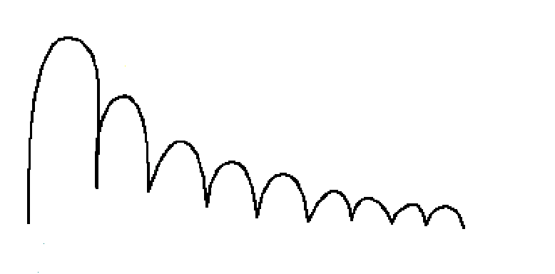
High and varying H₂ generation
rate causes dosimetry errors.
Uniformity Out of Spec
During This Interval
H₂
Pressure
(P)
P_{MAX}
(For
process
uniformity
req’t)
Time
up
up
up
dwn
dwn
dwn
(Scan Motion)

Slide 244
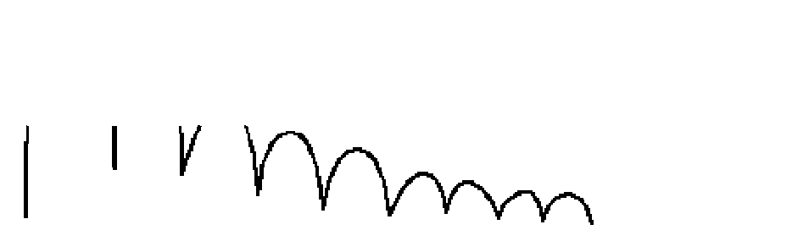
Dose holds maintain uniformity,
but cause throughput loss.
Dose holds limit H₂
pressure
H₂
Pressure
(P)
BUT . . . the time scale stretches out as disk scanning stops for each hold
P_{MAX}
(For
process
uniformity
req’t)
Time
up
dwn
dwn

Slide 245
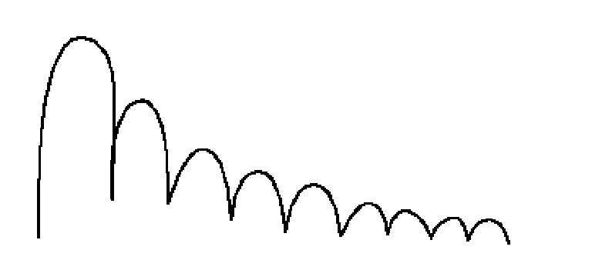
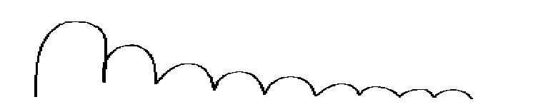
Solution: More H₂ Pumping
Speed
P=Q/S
Constant Q and higher S means P decreases
H₂
Pressure
(P)
P_{MAX}
(For
process
uniformity
req’t)
Time
up
up
up
dwn
dwn
dwn

Slide 246
. . . but H₂ speed falls off as the cryopump’s charcoal fills up with H₂.
S(H)
Speed
H, Liters
H₂ Liters Accumulated after Regen = H(T)

Slide 247
And, a Cryopump’s H₂ Pumping Speed is Highest right after Regeneration:
When the pump’s charcoal is empty
H2 Capacity is at it’s Maximum
S(H)
Speed
H, Liters
H₂ Liters Accumulated after Regen = H(T)

Slide 248
To Maximize The Pump’s H₂ Speed, Regenerate As Frequently As Possible
On-Board FastRegenTM During Source Change
Full Regeneration During Monthly Source PM’s

Slide 249
On-Board® FastRegen™ Control
First stage regeneration is rarely needed
FastRegen restores air and H₂ capacity
The Result: 100% process performance restored in the minimum amount of time - approximately 1 Hour
Notes:
EXPLAIN THAT THE PUMP STAYS RUNNING...
KEY: 100% OF CAPACITY IS RESTORED...

Slide 250
Traditionally, User inclination was to do infrequent regens. . . varying H₂ Speed lead to varying process uniformity
H₂ Speed
Pump’s
Rated
Speed
Time
Regeneration

Slide 251
FastRegen during source changes: Higher, more stable speed... leading to more stable process uniformity
H₂ Speed
Pump’s
Rated
Speed
Time

Slide 252
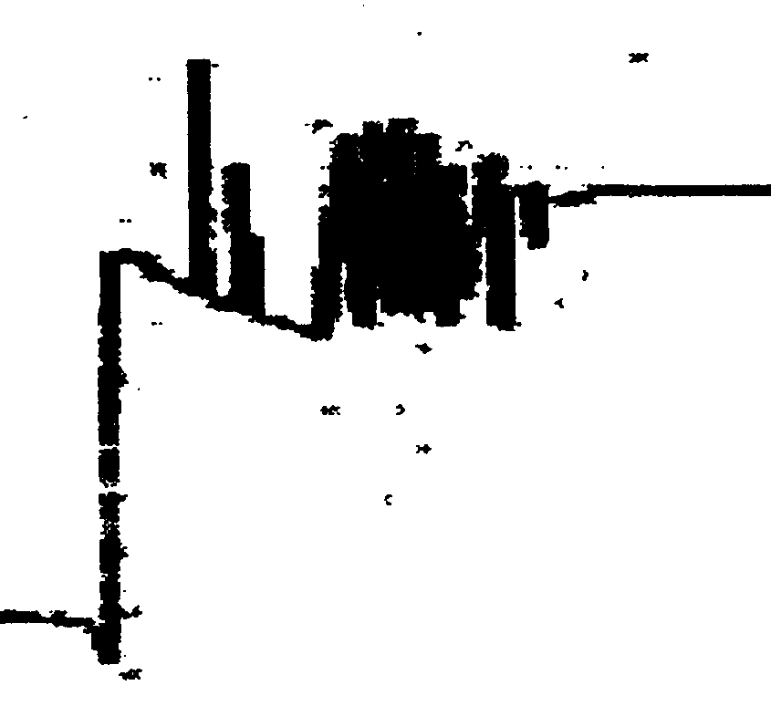
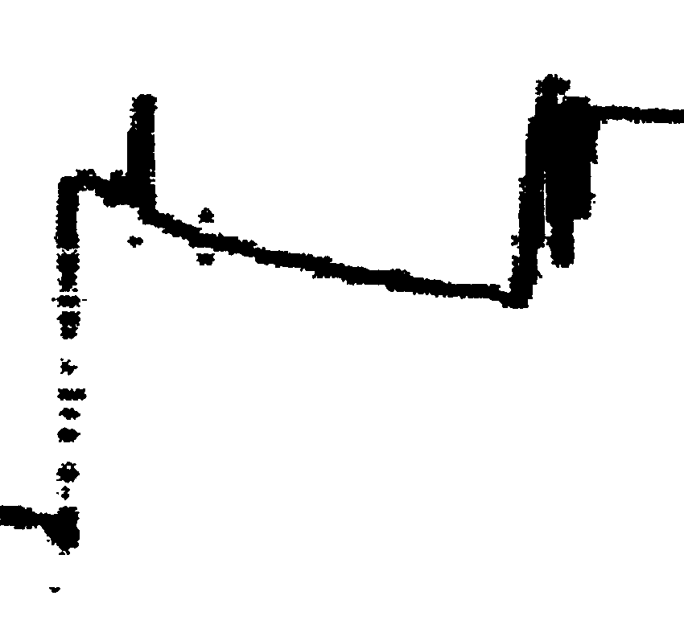
Observed Results - Reduced Dose Holds
Before
After
6-7 Holds
2 Holds
Implanter - Eaton NV-10
Process - 6.5 mA, BF₂ , 65KeV

Slide 253
Observed Results - Improved Implanter Availability
Implanter - Eaton NV-10
Hours
Down
Pre-Install Experience
One Year
80
60
40
20
0
MONTHS
On-Board® Cryopumps
Installed
Notes:
Slide 11
This slide shows a year’s data after installing On-Board cryopumps in an implant application. Before install, regeneration was causing TANGIBLE tool downtime of 50-75 hours per month. After install, with FastRegen in parallel with source changes, this downtime was eliminated.

Slide 254
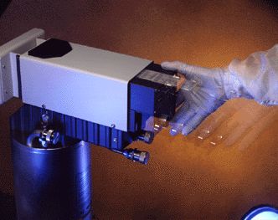
Improved Full Regeneration for Ion Implantation

Slide 255
In “Dirtier” Implant
Processes . . .
Photoresist by-products load the cryopump with gummy hydrocarbon residue
Residues outgas when the cryopump warms for full regeneration

Slide 256
In “Dirtier” Implant
Processes . . .
This increases the required rough time and number of repurge cycles. Result: very long full regens
The effect is process specific:
  Build-up rate varies with current and amount of resist
  Some processes do not display this behavior at all

Slide 257
New On-Board Module for Ion Implanters
Higher-temperature warm-up
  Faster outgassing
Simultaneous rough/purge (instead of simple purge)
  Faster outgassing and faster gas removal
Results:
  Faster, more consist regenerations
  Especially useful in high-current/high-throughput applications

Slide 258
Previous Routine
Temperature ( )
310K
Pressure ( )
Purge at ATM Pressure
ATM
Warm
Purge
Rough ROR
Cool

Slide 259
New Routine
Temperature ( )
330K
Pressure ( )
310K
Higher Temperature
Simultaneous purge and rough
ATM
Warm
Purge
Rough ROR
Cool

Slide 260
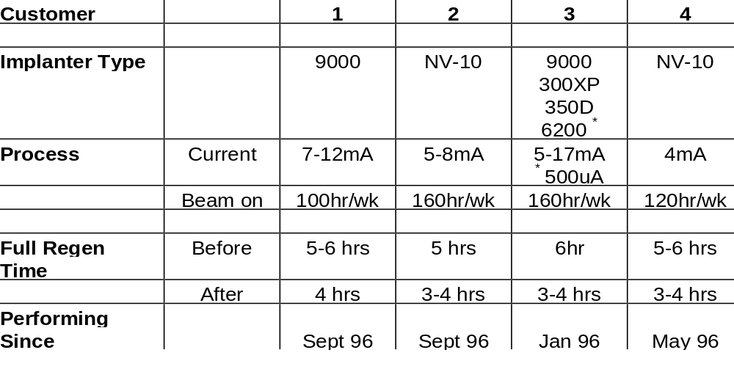
Field Test Results

Slide 261
GUTS
24 Hours a Day
7 Days a Week
365 Days a Year
1 Hour Response
Answered by a Qualified Service Engineer
Notes:
ONE MORE THING.... GUTS... EXPLAIN IN DETAIL...
NOTE: BE SURE THAT PEOPLE UNDERSTAND THAT THIS IS NOT A POLICY THAT THEY HAVE TO BUY... ITS FREE WHEN YOU BUY THE BLUE LABEL....

Slide 262
On-Board Central Control
for WindowsTM
PROCESS TOOL

Slide 263
On-Board Central Control
for WindowsTM
PROCESS TOOL

Slide 264
On-Board Central Control
for WindowsTM
PROCESS TOOL

Slide 265
On-Board Central Control
for WindowsTM
PROCESS TOOL

Slide 266
On-Board Central Control
for WindowsTM
PROCESS TOOL

Slide 267
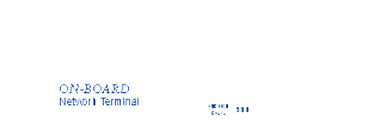
On-Board Central Control
for WindowsTM
NETWORKED PROCESS TOOL
Network Terminal

Slide 268
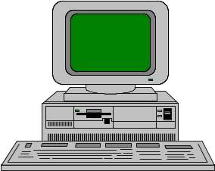
On-Board Central Control
for WindowsTM
NETWORKED PROCESS TOOL
PC with On-Board Central
Control Software for Windows
Network Terminal

Slide 269
On-Board Central Control
for WindowsTM
PROCESS TOOLS
Network Terminal
Network Terminal
Network Terminal
Network Terminal

Slide 270
On-Board Central Control
for WindowsTM
PROCESS TOOLS
Network Terminal
Network Terminal
Network Terminal
Network Terminal

Slide 271
On-Board Central Control
for WindowsTM
PROCESS TOOLS
Network Terminal
Network Terminal
Network Terminal
Network Terminal

Slide 272
On-Board Central Control
for WindowsTM
PROCESS TOOLS
Network Terminal
Network Terminal
Network Terminal
Network Terminal

Slide 273
On-Board Central Control
for WindowsTM
NETWORKED PROCESS TOOLS
Network Terminal
Network Terminal
Network Terminal
Network Terminal
On-Board NetLink

Slide 274
On-Board Central Control
for WindowsTM
NETWORKED PROCESS TOOLS
Network Terminal
Network Terminal
Network Terminal
Network Terminal
PC with On-Board Central
Control Software for Windows
On-Board NetLink

